Slide 1

Reflective Psychotherapy
David L Roberts, PhD
Associate Professor of Psychiatry

Slide 2
Summary of MI

Slide 3

Motivational Interviewing (MI)
MI is a method of talking with clients about change.
Target Behavior = the change the client is facing (“The change the client wants or needs to make”)
What are some changes you want your clients to make?

Slide 4
MI works in two ways
Neutralizes client’s resistance to working with you & talking about change
  MI Spirit
  OARS
  Rolling With Resistance
Fosters change in the client
  Evoke Change Talk
Resistance is
any factor within the client that prevents them from changing.
EG: fears, negative expectations, lack of knowledge, desire to maintain status quo…

Slide 5
Resistance exercise
Think of somebody you know.
Think of a change they ”should” make.
What are some internal factors within them that pull against them making this change?
Type examples in chat box (not too much detail). EG:
  He thinks he knows how to do it, but he doesn’t.
  They don’t prioritize it over over things.
  She doesn’t really know what she wants.

Slide 6
Resistance in Ourselves
Also:
Bring to mind 1 or 2 of your current or past clients. Consider how the techniques we discuss today fit with them.
Think of a change that maybe you should make.
Let’s hear about a couple of our examples.
Notice how we naturally describe it…

Slide 7
Ambivalence = Pulled in Two Directions
Our blueprint is to move toward health and growth
Resistance/Sustain
Change
Helps manage stress
Wife hates it
Physically addicted
Don't want wife to be right
Health - discomfort
Longevity, for kids
Smoking

Slide 8
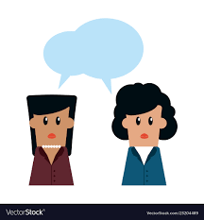
What happens when you talk to an ambivalent client?

Slide 9
You hear both sides
I don’t deserve better.
This is just how my life is.
It’s not worth the effort.
It’s mostly for my son.
I don’t have a choice.
I’m looking forward to getting back on track.
I know it’s worth the effort.
I care about my health.
I’m scared to try.
Sustain Talk=
Pt talk about factors that pull away from change
Change Talk = Pt talk about factors that pull toward change
It’s not my fault.
I don’t have the willpower.
I was doing better for a while.
It’s not that serious.
I know what I have to do.
Target Behavior

Slide 10
Your Goal: Tilt the scale toward change
The “Righting Reflex”
Sustain
Status quo
Change
Target Behavior

Slide 11

But in therapy it's Opposite Day
If you try to push down on the Change side of the scale by convincing the client to change, this may CREATE resistance in the client.
“Don’t push me”
Don’t judge me”
“You don’t understand”
“You don’t really care”

Slide 12
Resistance about the Helper Relationship
The Ineffective Dentist
It’s not about the nail

Slide 13
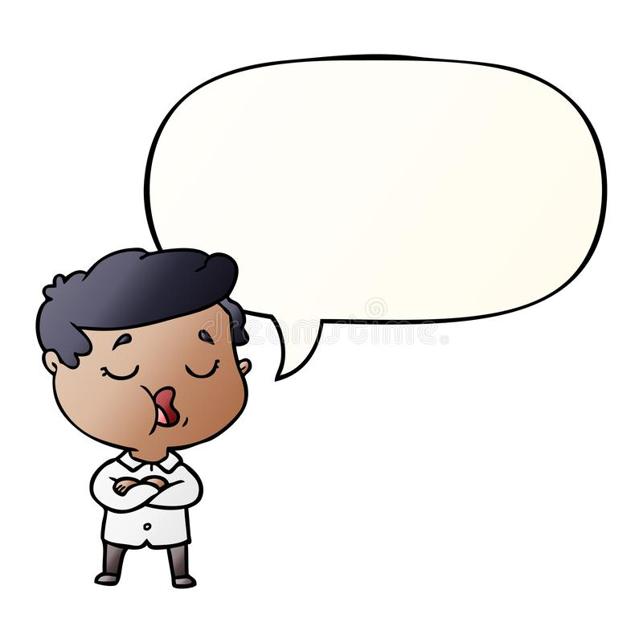
You can decrease client’s resistance by being person-centered
Sustain
Change
I care about my health.
I’m looking forward to getting back on track.
I know what I have to do.
It’s not my fault.
I know it’s worth the effort.
It’s not that serious.
It’s mostly for my son.
It’s not worth the effort.
I was doing better for a while.
It’s not worth the effort.
Target Behavior
It’s not worth the effort.
That sounds really hard.

Slide 14
…and increase motivation for change by Evoking Change Talk
Sustain
Change
It’s not worth the effort.
It’s not my fault.
I know what I have to do.
It’s not that serious.
I was doing better for a while.
I know it’s worth the effort.
It’s mostly for my son.
My family will be proud.
I will feel a weight off my shoulders.
Why would you want to change?
Target Behavior
I can do this.
I’m looking forward to getting back on track.
I care about my health.

Slide 15
Change Talk
Change Talk is client speech that favors movement in the direction of change.
Sustain Talk is client speech that favors the status quo.
They both occur naturally in conversations about change; but strategies help draw out more or less.
You want the client to voice more change talk, to make the argument for their own change. So you ask the client questions that will have Change Talk as the answer.
“I feel great sober.”
“I don’t know how to change it.”

Slide 16
Evoking Change Talk
Questions that have Change Talk as the answer:
Why would you want to change?
What is wrong with the way things are now?
How important is it to change?
If you decide to change, what makes you feel confident that you can?
What would it feel like if you tried and succeeded in making this change?

Slide 17
PLAN
RECAP all change talk
Evoke
- Menu of options
- First steps
The Four Processes
EVOKE Change Talk
Desire, Ability,
Reasons, Need
8 strategies..
FOCUS
Evoke Target Behavior
Focus on
Target Behavior
OARS
Evoking Change Talk
DARN-C
ENGAGE
Role Clarity
Build Trust
Drain the Swamp
OARS
Evoke Change Talk w
emphasis on DARN
Don’t evoke Sustain Talk
OARS
Deeper reflections
Double-sided
reflections to develop
discrepancy
Exploring ambivalence
OARS
Simple reflections

Slide 18
MI and Psychotherapy
Useful as adjunct to increase motivation to engage in specific psychotherapy activities.
  Exposure in anxiety
  Behavioral Activation in depression
Useful as general framework in which to deliver therapy approaches.
  Maximize engagement
  Build intrinsic motivation
Not a stand-alone psychotherapy
Arkowitz, Miller & Rollnick (2015); Atkinson & Earnshaw (2020); Iarussi (2020)

Slide 19
Why is MI not considered a Psychotherapy?
MI is a generic tool for increasing intrinsic motivation for ANY change.
BUT
It does not provide targeted intervention for any specific conditions, such as depression or anxiety. It ends at "Planning".
MI does not pass "The OCD Test."

Slide 20
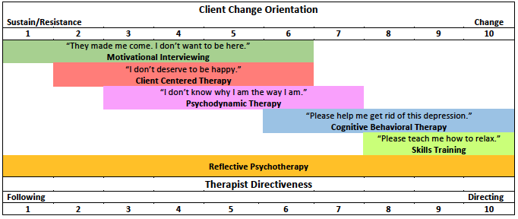
Where is the change your client needs?
"Can you teach me to beat my OCD?"

Slide 21
What does MI need to become a Psychotherapy?
A psychotherapeutic theory and frame.
Targeted change tools that pass the OCD test.
Reflective Psychotherapy is my effort to incorporate these in order to use MI as a comprehensive psychotherapy in community practice settings.

Slide 22
Reflective Psychotherapy
(RP)

Slide 23
Reflective Psychotherapy: The Theory
The Need for Therapy
Three types of Ambivalence
People are intrinsically motivated toward growth/health.
Difficulty overcoming obstacles can diminish intrinsic motivation & foster resistance to growth.
Client's ambivalence between change and status quo
Client's ambivalence about collaborating with the therapist to change
Therapist's ambivalence between non-directive and directive therapy approaches
  See next slide
The Process of Therapy
From Resistance to Ambivalence
From Ambivalence to Change

Slide 24
Therapist's Ambivalence between
Non-Directive & Directive Techniques
Non-Directive
Directive
Client defines the problem & the path to change
OARS & MI Spirit
  Evoking (vs. Telling)
  Autonomy Support
  Compassion & Acceptance
Good for engagement, but can struggle to achieve change
Empirical or theoretical model defines the problem and the path to change
Therapist engages client in following model-based procedures
Good for fixing symptoms, but can struggle with engagement
Which feels more
natural to you?

Slide 25
The Process of Therapy
Sustain/Resistance Client Change Orientation (CCO) Change
1 2 3 4 5 6 7 8 9 10
Following Therapist Directiveness (TD) Directing
1 2 3 4 5 6 7 8 9 10

Slide 26
Reflective Psychotherapy: The Frame
RP is for clients who:
  See a problem with the status quo in their life,
  Want a change,
  See themself as the person to make the change,
  See the therapist as a collaborator in the change process.
Achieving A through D can be tasks of Engaging & Focusing.

Slide 27
From Resistance to Ambivalence
MI Spirit
OARS
Rolling with Resistance

Slide 28
Meet the Client in their Resistance
Client Change Orientation (CCO)
Sustain/Resistance Change
1 2 3 4 5 6 7 8 9 10
Therapist Directiveness (TD)
Following DIrecting
1 2 3 4 5 6 7 8 9 10
Therapy Process
Engaging Focusing Evoking Planning

Slide 29
Why meet the client in their resistance?
To understand why/how they feel blocked
  So that you won't make suggestions they have already tried
  To find the seeds of Change
To validate their valid feelings and experiences of stuckness
  So they are less ashamed
  So they are less likely to feel judged
  So they don't have to keep repeating or shouting resistance at you

Slide 30
Rollnick Primary Care Video
Track in Chat: Open Questions, Closed Questions, Reflections.
Discuss
How does Rollnick meet the client in Resistance?
How does he Roll with Resistance?
  Technical tools?
  Spirit/attitude?
How does he get the client to Ambivalence?
Other observations?

Slide 31
From Description of Problem to Discussion of Change
Use Reflections of therapy assumptions & DARN Questions to ground conversation in the Frame of therapy and the Change Scale.
"You're not OK going on like this."
"You want a change."
”Even though it’s not fair, you know you have to be the one to do it."
"This isn't going to be easy. You want my help figuring it out."

Slide 32

MI Spirit
  Collaboration between the practitioner and the client
  Evoking or drawing out the client‘s ideas about change
  Emphasizing the autonomy of the client
  Practicing compassion and acceptance in the process

Slide 33

Open-ended questions
Affirmations
Reflections
Summaries
OARS
> 50% Reflections
30% Open-Questions
A few affirmations and summaries

Slide 34
Open Questions

Slide 35
Open Questions (vs. Closed)
Criteria for Open Questions
Do these questions meet criteria 1-4?
What is your psychiatric diagnosis?
Is this good or bad?
Isn't that great?
Don't you think it's time for a change?
How many times have you been to the hospital?
Are you taking your meds as prescribed?
How can we keep you safe?
Open the door for the client to give their perspective on a topic
Do not define the terms of the conversation
Do not define response options
Do not suggest a preferred answer

Slide 36
Using Open Questions in Engaging & Focusing
Understand the Problem
  "What brings you in?" "Why today?"
  "How do you understand what's happening/causing this?"
  "That's one part of it. What other difficulties are there?"
Understand the Sustain/Resistance (internal blockage)
  "What are you trying that's not working?"
Understand the client's hopes for therapy
  "How are you hoping I can help?"
  "What are your best hopes for what could come from our work together?"

Slide 37
Using Open Questions in Focusing to Narrow in on Target Behavior
“For some people, anxiety is mostly about how they are thinking or talking to themselves. For others, the biggest part is how they feel in their body (rapid heart rate, etc.). For some it’s a combo of these. For other people, this way of looking at it isn’t useful. I wonder what anxiety looks like for you.”

Slide 38
Using Open Questions to Evoke Sustain Talk & Change Talk: DARN Questions
Client Sustain Talk & Change Talk tends to come in 4 categories:
D Desire (feeling)
A Ability (confidence)
R Reasons
N Need (importance)

Slide 39
Sustain talk-DARN vs. Change talk-DARN
Desire:
”I love smoking.”
Ability:
”I’ve tried and I don’t think I can quit smoking.”
Reasons:
”Smoking helps me to focus.”
Need:
“I have to smoke. I can’t get through the day without it.”
Desire (feeling):
“I’m excited about quitting.”
Ability (confidence):
“I’ve accomplished some hard things in my life. I can quit.”
Reasons:
“If I quit, I could play soccer with my kids.”
Need (Importance):
“This has to stop. I could die.”

Slide 40
Sample DARN Questions
What do you like about being sober?
DESIRE
How have you been able to make changes in the past
ABILITY
Why would you want to take these medications?
REASONS
How important is it for you to be able to walk?
NEED

Slide 41

Reflections

Slide 42
Reflections
“Do you feel sad?”
becomes
“You're sad.”
Are statements rather than questions
  Often a question can be turned into a reflection.
Make a guess about the meaning, rather than asking
  …by attending to non-verbal cues, tone, words, and knowledge of the client
Like testing a hypothesis
  “You like feel sad…”
OARS
Notes:
Explain how good reflective-listening statements are very similar to the “Do you mean . . ." questions. They offer a hypothesis about what the speaker means, but the difference is that this is done in the form of a statement rather than a question. The listener’s voice turns down at the end of a reflective listening statement (difference in inflection at the end of the sentence).
Illustrate by inflecting the word "said" differently in this sentence: "You're angry about what I said?" (up) vs. "You're angry about what I said." (down). Do this several times. Have them repeat it with you—it’s hard for some people.
It may feel presumptuous, as if you are "telling the person what they feel." Yet statements work better and lead to clarification and greater exploration, whereas questions tend to interrupt the Family’s flow.
*Remember there is no penalty for missing: Even if your statements are not completely accurate reflections may help the speaker to perceive the listener as “trying” and they may be inclined to communicate more of themselves.
A reflection states hypothesis--makes a guess about what the person means
Form a statement, not a question
Recall: “Do you mean that you . . . ?”
Cut the question words “Do you mean that ”
Simply begin, “You ...”
Inflect your voice down at the end
No penalty for missing
Generally, should not be longer than the person’s statement
Reflective listening is a primary skill. It is the pathway for engaging others in relationships, building trust, and fostering motivation to change.
Reflective listening facilitates the Family’s focus on his or her knowledge and resources.
Reflections are always collaborative and non-judgmental and completely focused on the speaker.
Reflective listening works because it checks with the speaker to see that a statement has been correctly heard and understood. The goal is to improve mutual understanding.
Point to make: Most of the time when we listen, we simply say, “yeah, I get you” or “sure, I understand.” But do we really? Much of the time, we don’t.
Often we make assumptions about what the person meant by their words because their words were filtered through our own lens of knowledge and past experience.

Slide 43
Levels of Reflection
Simple Reflection
  Repetition
  Rephrase
  Speaking as the client
Complex Reflection (guess)
  Reflection of feeling, deeper meaning metaphor, etc.
  Double-sided
  Amplified / Stark

Slide 44

Reflective Listening
You’re disappointed. You put a lot of work into this.
It’s so funny that I thought I could do it. What a joke!
Complex reflections access unspoken meanings and potentials.

Slide 45

Reflections are statements, not questions
Keep your tail down!
Question:
Your sister is jealous of you?
Reflection:
Your sister is jealous of you.

Slide 46
How reflections work
They communicate understanding.
They focus attention on client's experience, not therapist's perspective.
They do not pressure the person to answer a question.
  Questions are more about your agenda than the client’s.
Client feels heard and cared about.
They encourage introspective exploration.

Slide 47
How reflections work
They are less likely to evoke defensiveness than a question because they are less likely to sound judgmental.
Client: “I use cocaine everyday, but I definitely don’t have a problem with it.”
Interviewer: ”You don’t see it as a problem?”
vs.
Interviewer: “You don’t see it as a problem.”

Slide 48
Using Complex Reflections to Make Interpretations
Complex reflections leverage the gap between what the client says and what they mean.
C: "Well, I'm back where I started."
T: "You’re thinking your brother's to blame for this."
So, there is risk the client may reject your complex reflection
Because you are wrong or client cannot see it (insight/defended)

Slide 49
It is OK to be wrong w Complex Reflections
If you are in MI Spirit, client will not feel judged
Opportunity to show client you are happy to be corrected
Not OK to be wrong 4 times in a row
  Not listening

Slide 50
Soften Reflections to make them palatable
Good for complex reflections when the client may want to avoid or you have shaky rapport.
"A part of you thinks...." "A part of you wants to say.."
"You almost feel..."
"Sometimes a part of you almost wishes..."
"It almost sounds like you're saying..."
"Sometimes it seems like a part of you thinks..."
"There's sometimes a voice saying..."

Slide 51
Stark Reflections to Clarify Resistance &
Find Seeds of Change
"There is nothing that could happen that would make you decide to change."
"At the end of the day, you have to put yourself first."
"If it came down to it, you would prioritize your friends over your health."
"You would rather be lonely the rest of your life than be disappointed by a friend one more time.”
"You're not here because you think you have a problem. You're here because they sent you here, and that's the ONLY reason you're here."

Slide 52
Exercise: Batting Practice
"Client" briefly describes change they are facing/considering
Others in group take turns doing reflections
  Try for Complex Reflections
  Don't circle the drain
  Don't make suggestions/give your opinion
  Client Tip: Give some elaboration in response to each reflection (to give fodder for the next person to work with)

Slide 53
Rolling with
Resistance

Slide 54
Resistance in MI
Resistance = Sustain Talk + Discord
Sustain talk is a normal aspect of ambivalence and change. It is about the target behavior
Discord is dissonance in the therapeutic relationship. It is about the relationship. Often includes the word, “you”:
“You don’t understand how hard it is for me.”
“You can’t tell me what to do.”
“I’m not sure if you can really help me.”
“You’re not listening to me.”
“You’re just trying to bill my insurance.”
Notes:
The MI conceptualization of resistance emerges from the observation that what clinicians call resistance is a combination of (a) sustain talk, a normal manifestation of ambivalence, and (b) dissonance in the therapeutic relationship. This latter is highly responsive to clinician style and can be dialed up or dialed down by clinician behaviors (Glynn & Moyers, 2010; Petterson & Forgatch, 1985).

Slide 55
Type in the Chat Box
Examples of how a client’s religion, ethnicity or socioeconomic background can contribute to
Resistance OR
Motivation for Change

Slide 56
How is resistance addressed in MI?
The Goal:
Allow the client to voice sustain talk & discord freely, without feeling pressured to change or worrying about being judged.
It is only possible to use the techniques of MI when the client feels free to express sustain talk.
Turn the resistance around: Neutralize it, and find Change Talk.

Slide 57
Draining the Swamp:
When the Resistance includes Discord...
The challenge is to maintain engagement.
Keep the conversation real AND about change/resistance.
Often means discussing something uncomfortable, about "us."
  "You're wondering if I can be helpful to you."
  "You're concerned about my ability to help you."
  "I appreciate your willingness to talk with me about this.”
  "It's not easy to talk about this."

Slide 58
Techniques for Responding to Resistance
Validate experience – Reflections
Evoke to Drain the swamp – Open questions
Double-sided reflections: Include both sides of resistance.
Amplified reflections/Siding with Sustain: Shows understanding while defusing the intensity of resistance.
Reframing: Recasts resistant or sustain talk element in a new light.
Emphasizing personal choice and control (autonomy): Recognize the obvious—that any change is entirely the client’s choice.

Slide 59
Amplified Reflection
Exaggerates a resistant statement so that the client will disagree.
Client: I’m sick of going to the doctor all the time. It’s a hassle and it gets in the way of the online gaming that I like to do.

Slide 60
Amplified Reflection
Member: I’m sick of going to the doctor all the time. It’s a hassle and it gets in the way of the online gaming that I like to do.
Sample reflection:
Having fun is really important to you, more important than your health.

Slide 61
Examples of reframing
Client: I don’t know if I can do it.
Interviewer: It would be quite a challenge—hard work!
Client: My wife is always nagging me about this.
Interviewer: She must really care about you.
Client: I’ve been through so much lately. I don’t know if I can take this on.
Interviewer: You’re quite a survivor.
Reframe failure as a step on the way to change (eg, quitting smoking).

Slide 62
Rounder Video

Slide 63
From Engagement to Change
Evoke & Validate
Sustain Talk
to engage
Amount of Talk
Evoke & Affirm
Change Talk to motivate
Time/Rapport

Slide 64
Roleplay #1
Client: Realplay (a change you are considering) OR Roleplay (a fictional client)
Tip: Don’t talk too much or too little.
Provider: Pick your Goal:
Balance Reflections and OQ’s
Avoid suggestions and planning
Double-sided reflection
Stark/Amplified reflection
Deep listening/MI Spirit
Match TD to CCO
Etc.

Slide 65
Summaries

Slide 66
Summaries
Like long reflections that integrate at least 3 previous reflections
Useful to deliver conceptualization in the form of a reflection
  See next slide
"Bouquet Summary" to frame change (Living with Diabetes)
Useful for transitions between parts of conversation
  "That's one piece of it. What else?"

Slide 67
Using Summaries for Conceptualization
Double-sided Summary during Focusing
"On the one hand X, on the other hand Y. Where does this leave you?"
Let's try a few of these.

Slide 68
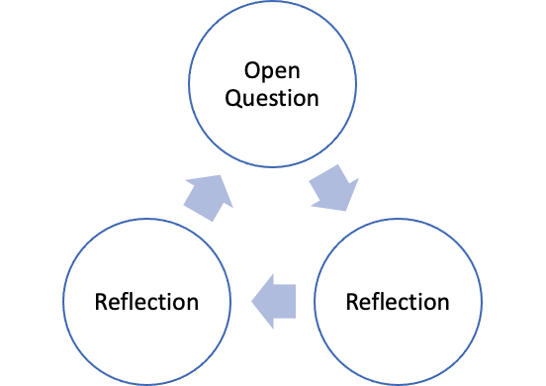
ORR Cycle
OQ to draw out client's perspective
R to deepen & discover
R to advance
Repeat

Slide 69
Roleplay #1 – 5 minutes
Pair off. 2 roleplays: One as client, one as provider
Client:
  "A change I want to or should make." Share honest resistance.
  Don't talk too much or too little.
Provider
  Use MI Spirit & OARS
  Balance Reflections & Open Questions
  Avoid suggestions, confrontation, personal disclosure

Slide 70
Affirmations
& Validations

Slide 71
Techniques
Open-ended questions
Affirmations
Reflections
Summarization
OARS
> 50% Reflections
30% Open-Questions
A few affirmations and summaries.
O-R-R
Notes:
OARS micro skills are essential to developing the empathy, rapport and understanding necessary to foster change. These skills also help speakers to resolve ambivalence, enhance intrinsic motivation, and build confidence to change.
Essentially, these micro skills help us as listeners to truly focus on what the other person is saying and to get their perspective.
Discuss: OARS is not merely an acronym, but also a metaphor. Ask what oars might symbolize.
If the following are not mentioned, add:
The oars are its steering mechanism, tools which propel/move the boat forward.
Without oars we would drift along and lose control of where we’re going.
Skillful use not only propels the boat, but gives it direction.
If only one person is paddling it will go very slowly and require a lot of hard work on tat one person’s part.
Got to paddle together/ in sync to move the boat in the right direction.—almost like dancing. What happens if both try to lead or no one does?
We are going to re-arrange this acronym- still keeping in spirit with the oars metaphor- ROAS (rows) as in row the boat- by discussing Reflection first, then open-ended and closed ended questions, affirmations and, lastly, summarization.

Slide 72
Affirmations
Affirmations are statements that recognize client strengths and acknowledge behaviors that lead in the direction of positive change, no matter how big or small.
Affirmations build confidence in one’s ability to change.
  Communicate “You are already moving toward health/growth.”
Affirmations typically sound like compliments.
To be effective, Affirmations must be genuine.

Slide 73
Examples of Affirmations
You had to do a lot of work to get here today.
You have learned a lot about the system.
You are clearly a very resourceful person.
You are willing to work hard to get results.
You hold yourself to high standards.
You have a deep understanding of your illness.
It really looks to me like you are going to succeed.
I can see that you are already making changes.

Slide 74
Affirmation vs Validation
Affirmations are always change-oriented
  “Given how bad your depression is, I’m impressed you made it in to talk to me.”
Validations are often resistance- or sustain-oriented
  “I can totally understand how your depression has kept you from getting out of bed this week.”

Slide 75
Focusing

Slide 76

Focusing
Efficiency
  Keep Conversation on question of change
  Balance Directing and Following strategies
Build motivation by Developing Discrepancy
Find seeds of Change in Sustain
Ambivalence-based Conceptualization

Slide 77
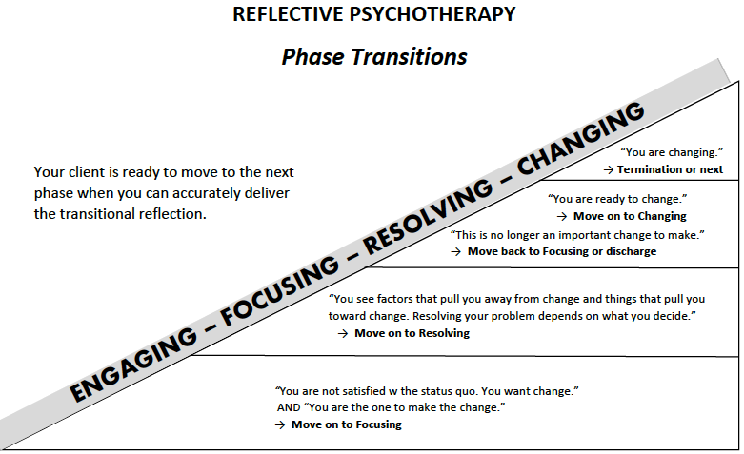

Slide 78
Guiding: Balance Directing and Following
First, direct to the topic that you want to discuss with the client.
T: “Can we talk about your relationship with Ed?”
Then hand it over and follow the client:
C: “OK. What do you want to talk about?”
T: “I just want to know how you feel about it.”

Slide 79
Build Intrinsic Motivation by Developing Discrepancy
Discrepancy = Disconnect between values/goals and target behavior
Discrepancy & Cognitive Dissonance
  We all want to be internally consistent
  Anxious discomfort when inconsistent; felt need for resolution
Techniques to Develop Discrepancy
  Reflect: “The status quo is not acceptable to you.”
  Stark/Amplified Reflections: "Something has to change."
  Double-sided reflections: “You’re torn in two directions.”
  Hand it over to follow: "Where do we go from here?"

Slide 80
Finding seeds of Change in Sustain
"Given how hard this is…”
“Given how frightening this is…”
”Given how big the obstacles are..."
"….You must really care about this change.” OR
(reflecting Change Talk)
"….I'm impressed that you are trying."
(affirmation)

Slide 81
Finding seeds of Change in Sustain
Hypothetically remove the biggest part of Sustain in order to unleash Change Talk.
"If there was something in it for you, you might be willing to do some of this stuff.”
"If you could find a way to do it that you enjoy, you would do it.”
"What would make this easier is if your father wasn't so critical of your efforts."
"What would make this easier is if you had a coach of some sort."
These can be phrased as
reflections or open questions.

Slide 82
Finding seeds of Change in Sustain:
Make the Change side Hypothetical
Reflection: "If it weren't for X, you would change."
  EG: "If it weren't for transportation issues, you would definitely look for a job."
Open Question: "If you did decide to change, what would make it hard?”

Slide 83
Exercise: Speaking as if you wanted to change
Pair up.
Client identifies TB.
Therapist evokes around theme: “What would make it hard to change?”
TIPS
Goal is to evoke so that client speaks from the perspective of person trying to change (“As if”)
Works well when there is a clear TB and client is feeling pushed to change.
  “My partner wants me to change but I don’t have to and I don’t want to.”
Helps client access inner psychological basis for resistance
  “If we imagine for a minute that you DID want to make this change they’re talking about, what do you think would make it hard for you to do?”
  Diverts attention from interpersonally-based resistance
Often uncovers low Ability/Confidence
  Reflect: “You almost feel like you couldn’t quit even if you wanted to.”

Slide 84
Ambivalence-based Conceptualization

Slide 85
Exploring Ambivalences
Sustain Talk | Change Talk
I’m never going to get out of this. I’ve done therapy before. It doesn’t help. I’ve tried everything. Nothing works. I don’t really believe in psychotherapy. I don’t have the willpower. I don't deserve to change. Apparently I’m supposed to be unhappy. I’m afraid to fail. It’s outside of my control. | I need to find a way forward. I know what needs to change. I want to get back to feeling good. I need to be the person I know I can be. Exercise helps. I’ve learned things that take the edge off. My uncle is a big ally in this effort. There is nothing more important than this. I’m ready to do what it takes.

Slide 86
Common Ambivalence Themes
Change vs Status Quo
Anxiety
Expose vs avoid
Love vs Fear
Perfect vs Realistic
Certainty vs Uncertainty
Depression
Action vs Inaction
Fight vs Give up
Self/Identity
Ideal Self vs Real Self
This Me vs That Me
Accept Self vs Reject Self
Victim vs Hero
Positive vs Negative (Gala)

Slide 87
More Ambivalence Themes
Existential
Freedom vs Obligation
Alone vs Connected
Life vs Death
Meaning vs Meaninglessness
Reality vs Fantasy
Habitual vs Intentional
DBT
Acceptance vs Change
Reason vs Emotion
Value-driven vs Urge-driven
Willful vs Willing
Psychodynamic
Id vs Ego
Super-ego vs Ego

Slide 88
Case Example of Ambivalence: Gala
"What it comes down to is: Am I going to be a negative person or a positive person?"
Negative: Judgmental mother, bullied, moral injury in police dept. Suspicious husband accuses of infidelity, causing Gala to have anger outbursts. Chronic anger. "I hate people." Came to therapy feeling desperate. "Nothing has worked. I'm running out of options."
Positive: Ayahuasca retreat. Had compassion for self/others and joy for 2 weeks after. Until husband accused of infidelity. Now flipped back into Negative. Flips back and forth in session.

Slide 89
Gala Focusing
Stark Reflection: "If you could, you would want to be Positive Gala all the time. You would want to feel compassion for your coworkers despite their flaws."
If you could spend more time inhabiting the Positive....
Gardening
  What does that symbolize for you?
  How does this link with this push-and-pull around you being negative or positive?

Slide 90
Gala: Conceptualization with
Double-sided Summary
It's like you're saying you have these two ways of being Gala now. You've done both. You have been both. And you're stuck between which is going to define the future for you. Which you will inhabit.
So, Gala, where do we go from here?

Slide 91
Exercise: Ambivalence-based conceptualization in your clients
Small group discussion
Each person take 3-5 min to describe ambivalence theme(s) you see in:
  One of your clients (no PHI)
  A friend/family member
  Yourself

Slide 92
From Ambivalence to Change
Evoking Change Talk
Elicit-Provide-Elicit

Slide 93
Help the client make their own argument for change
Client Change Orientation (CCO)
Sustain/Resistance Change
1 2 3 4 5 6 7 8 9 10
Therapist Directiveness (TD)
Following DIrecting
1 2 3 4 5 6 7 8 9 10
Therapy Process
Engaging Focusing Evoking Planning

Slide 94
Evoking Change
Talk

Slide 95
Change Talk
Change Talk is client speech that favors movement in the direction of change.
Sustain Talk is client speech that favors the status quo.
They both occur naturally in conversations about change; but strategies help draw out more or less.
You want the client to voice more change talk, to make the argument for their own change.
“I feel great sober.”
“I don’t know how to change it.”

Slide 96
How does voicing Change Talk cause people to change?

Slide 97
Answer: Rehearsal & Self modeling
MI Spirit
OARS
Patient:
“I’m worried about my health.”
Hears self.
Thinks, ”Maybe I want to quit."
Explores more: "I would save money…"
Repetition leads to habit & fluency.
Why would you want to make this change?

Slide 98

To maximize client rehearsal of Change Talk...
Maximize the amount of time in session that the client is voicing change talk.

Slide 99
From Engagement to Change
Evoke & Validate
Sustain Talk
to engage
Amount of Talk
Evoke & Affirm
Change Talk to motivate
Time/Rapport

Slide 100
How Do You Evoke Change Talk?
Sustain
Change
It’s not worth the effort.
It’s not my fault.
I know what I have to do.
It’s not that serious.
I was doing better for a while.
I know it’s worth the effort.
It’s mostly for my son.
My family will be proud.
I will feel a weight off my shoulders.
?
Target Behavior
I can do this.
I’m looking forward to getting back on track.
I care about my health.

Slide 101
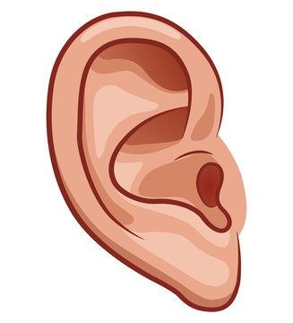
First you need to recognize Change Talk when you hear it.
“If I change, my family will stop worrying.”
“It’s pretty urgent.”
“I will feel a weight off my shoulders.”

Slide 102
DARN
Change and Sustain talk often fall into 4 basic categories:
Desire – Feelings about change
Ability – Confidence they can change
Reasons – All other reasons to change (or not change)
Need – Importance of change

Slide 103
“If I change, my family will stop worrying.” - REASONS
“It’s pretty urgent.” - NEED
“I will feel a weight off my shoulders.” - DESIRE

Slide 104
Listening for Change Talk: DARN
DESIRE to change (want, like, wish, feel……)
ABILITY to change (can, could……)
  Confidence
REASONS to change (if…then)
NEED to change (need, have to, must, got to…)
  Importance

Slide 105
Examples of Change Talk:
D, A, R, N?
I could get to class on time if I tried.
I think I could go for a walk.
I’ve got to do something about my depression.
I would have more fun if I accepted invitations.
I want to get my kids back, and I can’t do that unless I get a handle on my anger.

Slide 106
More examples:
D, A, R, N?
If I don’t start exercizing , I’ll die.
I’ve done it before.
My partner think I should do PE.
If I get in shape, I will be able to play basketball with my friends.
To get my own apartment, I need a clean urine sample.

Slide 107
Video: My Father also Hit Me
Practice recognizing MI in conversation

Slide 108
What do I do when I hear change talk?
Respond with EARS:
Ask a DARN Question
Do one of these:
Ask for Elaboration or an Example
Offer an Affirmation
Offer a Reflection
Offer a Summary – Bouquet Summary

Slide 109
Exercise:
Reflect the change talk in these statements
“Well, I wouldn’t mind taking pills if there weren’t so many side effects.”
“It would be really hard to change my diet. My whole family eats like this.”
“I used to run five miles a day.”
“I don’t like going to that doctor. I mean I guess I have to, but I don’t like the way she talks to me.”
“If you decrease my provider hours, I’ll have to cook for myself again.”

Slide 110
Eight Strategies for Evoking Change Talk
(See handout)
Evocative open questions – DARN-C
Reflect change talk
Ask for elaboration
Ask for examples
Affirmations
Rulers
- Importance
- Confidence
Look forward / back
Explore values and goals
Query extremes – best case / worst case

Slide 111
Gala: Evoking Change Talk
"Tell me more about how you saw yourself/others after Costa Rica."
"What does it feel like when you are gardening?" (Desire)
"How do you decide when to garden and what to do? How do you already use it to shift your feelings? What gardening projects are you working on now?" (Ability)
"Despite your conflicts and his jealousy, you love your husband and want to make it work." "Tell me more about that." (Reasons)
"How important is it for things to resolve on the side of Positive Gala?"
"When you're in Positive mindset, what do you want to say to Negative Gala?"
When Gala is in Negative mindset in session:
  "Is that Negative Gala? Is that who's talking now?"
  "How would Positive Gala be talking about this? Can I hear from her?"

Slide 112
Roleplay #2 – 5 minutes
Pair off. 2 roleplays: One as client, one as provider
Client:
  Client situation agreed with roleplay partner
  Don't talk too much or too little.
Provider
  Pick a goal at your learning edge
    More reflections?
    Evoke Change Talk?
    Try some double-sideds?
    Avoid suggestions?

Slide 113
Elicit-Provide-Elicit
I have come to feel that the only learning which significantly influences behavior is self-discovered, self-appropriated learning. -Carl Rogers

Slide 114
Elicit-Provide-Elicit (E-P-E)
Whenever you want to give information:
Focus: "Can we talk about smoking?"
Elicit: Ask what the client knows about the topic:
“What do you already understand about the health effects of smoking?”
Get permission to share information. Focus on client’s interest if possible.
“What else would you like to know about smoking?”
3. Provide the info, emphasizing that client can take it or leave it.
4. Ask what they think about the info you gave them.

Slide 115
Get Permission to Give Information
The person is more likely to hear and heed your advice if you have permission to give it.
Three forms of permission:
1. The client offers it (e.g., asks for advice)
2. You ask permission to give it
Would it be all right if I…? Would you like to hear…?
I could tell you some things other patients have done that worked. . .
3. You preface your advice with permission to disagree/disregard
▪ This may or may not be important to you . . .
▪ I don’t know if this will make sense to you . . .
▪ You may not agree . . .
▪ I don’t know how you’ll feel about this . . .
▪ Tell me what you think of this . . .
It’s often better to offer several options, rather than suggesting only one.
“There are a few things I’ve noticed can be
helpful…”

Slide 116
Planning / Directing

Slide 117

Offer more directive tools as you accumulate them
PE
CPT
EMDR
DBT
Mindfulness Skills
Cognitive Restructuring
Spiritual guidance
Etc.

Slide 118
Thank you for your participation!
David Roberts robertsd5@uthscsa.edu
Reflective Training www.reflectivetraining.org

