Slide 1
DBT Skills in the Living Room Context
Pisinee Dangwung & David Roberts
Notes:
Today, I am going to talk about DBT skills within the Living Room context.
Historically, the DBT skills are key component of the Living Room, especially when clients show up with suicidal ideation or non-suicidal self-harming behaviors.

Slide 2
Theoretical Foundations
Biosocial theory
Behaviorism/learning theories of change
Mindfulness principles
Dialectics
Notes:
There are 4 distinct theoretical foundations on which DBT was built.
Dialectics = finding truth in both sides of seemingly polar opposites
Learning to see things from multiple perspectives – not get stuck in one way – flexibility – no real or one truth in the world – always another side of the coin.

Slide 3
A bit of History
Developed by Marsha Linehan, Ph.D.
Originally designed as Tx for BPD (e.g. Linehan et al., 1991, 1993)
Reconceptualization of the disorder
Disorder of dysregulation
Notes:
DBT was originally designed as a treatment for Borderline PD. Treatment development involved reconceptualizing BPD as a disorder of dysregulation with 5 proposed areas.
Emotion dysregulation has been linked to a variety of mental health problems stemming from patterns of instability in emotion regulation, impulse control, interpersonal relationships, and self-image. DBT skills are aimed directly at these dysfunctional patterns.

Slide 4
Biosocial Theory
Emotional Vulnerability
Invalidating Environment
High sensitivity
High reactivity
Slow return to baseline
Indiscriminately rejects
Intermittently reinforces
Over-simplification of emotions
or experiences
A family or a sociocultural system that
constantly send the message that your emotions do not make
sense
Pervasive Emotional Dysregulation
Impulsivity
Emotional instability
Relationship problems

Slide 5
Disorder of Dysregulation
Areas of Dysregulation | Behaviors/Symptoms
Emotional Dysregulation | Emotional lability Excessive anger
Interpersonal Dysregulation | Interpersonal chaos Fear of abandonment
Behavioral Dysregulation | Impulsive behaviors Suicidality, Self-harm
Self Dysregulation | Identity confusion Emptiness
Cognitive Dysregulation | Dissociative responses Paranoid ideation
Notes:
As I mentioned earlier, Dr. Linehan reconceptualized BPD as a disorder of dysregulation. There are 5 types of dysregulations:
1. Emotion dysregulation
2. Interpersonal dysregulation
3. Behavioral dysregulation
4. Self-dysregulation
5. Cognitive dysregulation

Slide 6
Teach skillful behavior to replace problem behavior
Behaviors to increase | Behaviors to decrease
Mindfulness skills | Identity confusion Emptiness Cognitive dysregulation
Distress Tolerance skills | Impulsive behaviors Suicide threats Intentional self-harm
Emotion Regulation skills | Labile affect Excessive anger
Interpersonal Effectiveness skills | Interpersonal chaos Fear of abandonment

Slide 7
Subjective Units of Distress (SUDs)

Slide 8
Apply a Dialectical Approach
BALANCE
Change
Strategies
Acceptance Strategies
Dialectics

Slide 9
Balance the Skills
Emotion Regulation
Mindfulness
Change
Acceptance
Dialectic
Dialectics
Interpersonal Effectiveness
Distress
Tolerance
Notes:
Write this on the board!!!!

Slide 10
DBT in the Living Room
We apply mostly DBT acceptance skills in LR:
Mindfulness skills – mindfulness “What” and “How” skills, mindfulness of current thoughts/emotions
Distress Tolerance skills – STOP, TIPP, Distracting, Self-Soothing, Improving the moment, radical acceptance
Change skills might also be utilized if needed depending on:
Levels of SUDs
How well patient can stay in acceptance mind set while working on change strategies

Slide 11
Core Mindfulness Skills

Slide 14
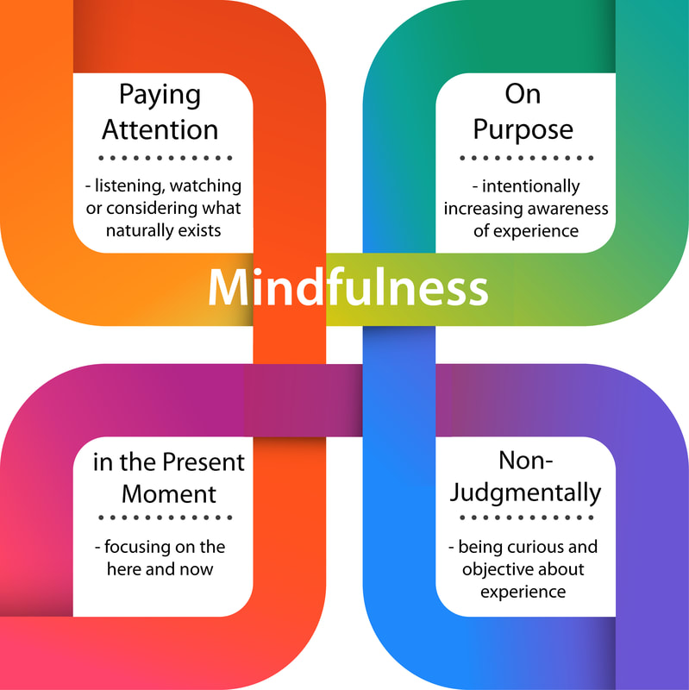
Mindfulness Definitions
The act of consciously focusing the mind in the present moment without judgment and without attachment to the moment.
Marsha Linehan
Paying attention in a particular way: on purpose, in the present moment and nonjudgmentally.
Jon Kabat- Zinn

Slide 15
STATES OF MIND in DBT Framework
What I KNOW to be…
What I FEEL to be…
What I THINK to be…
Emotion Mind
Reasonable Mind
Wise Mind
Cool, rational, task-focused
Dismissive of emotions, needs, desires
Hot, mood-dependent
emotion-focused
Crisis mode!
Strong urges
Hard to consider alternative
behavior
- Intuition
- Inner wisdom
Note: When you are in wise mind, it does not always feel comfortable!
Notes:
Scan to see which mind state you are in
Emo mind – check the facts. Ask yourself who what when where, use your 5 senses to ground yourself in the present moment
Logic mind – get in touch with how you feel – scan your body for emotions, ask yourself how a friend would feel in the situation
Reasonable mind – cool, rational, task-focused
When in reasonable mind – you’re ruled by facts, reason, logic, and pragmatics. Values and feelings are not important.
Reasonable mind is cold and dismissive of emotions, needs, and desires
Tasks: creating a budget, following a recipe, figuring out your bus route,
JOBS: software developer, scientists, surgeons, piolet, engineers, accountant, technical writer
How to know if you’re stuck in reasonable mind?
I keep pushing aside my own feelings, thinking they’re not important
I ignore body complaints such as headaches, backaches, and stomachaches,
I consistently ignore my intuition
People I love frequently tell me “I just don’t get it”
I coolly and rationally keep making the same mistakes over and over, especially in relationships.
I often feel clueless when someone I care about is really emotional
It is sometimes hard for me to understand why other people are so worked up about an issue.
I rarely experience strong emotions of any kind other than frustration.
I am lacking in experiences of joy and love. And instead I feel flat and dry.
I am often in a caregiving role for others while ignore my own needs.
Emotion mind – hot, mood-depended, emo-focused. Crisis mode! Facts & logic aren’t important.
When in emo mind – you’re ruled by your moods, feelings, and urges to do or say things. Facts, reason and logic are not important. Emotion is driving you, is in control.
Tasks: comforting a friend when they’re going through something rough, attending weddings or funeral, speaking up when someone is being harassed in public, falling in love!
Examples: use substances, binge watch a TV show,
JOBS: artists, novelist, teacher?, anything creative, event planner, interviewer, therapist?
How to recognize emotion mind?
I know the emotion I feel.
I cant take my mind off what I want to do
The outcome I am seeking feels very urgent
My body is full of strong sensations
It is hard to consider alternative behavior
Some facts seem more relevant than others
I am thinking of immediate rewards only
I don’t want to talk it over with anyone who might disagree
My body temp is up
Wise mind –
When emotion and reason merge, it leads to our intuition, inner wisdom, a feeling of knowing what’s right and effective—gut feeling. It brings us a sense of greater presence, openness, peace and clarity.
example- take time out in the middle of an argument, finding time to do mindfulness exercise during stressful time,

Slide 16
”What” Skills
Observe
Notice your body sensations
Pay attention to the present moment
Practice wordless watching
Observe both inside and outside of yourself

Slide 17
”What” Skills
Describe
Put words on the experiences
Label what you observe – name your feelings, thoughts, and actions
No interpretations and opinions – describe who, what, when, and where
Remember: if you can’t observe it through your senses, you can’t describe it

Slide 18
”What” Skills
Participate
Throw yourself completely into activities of current moment
Become one with whatever you are doing
Act intuitively from Wise Mind
Go with the flow

Slide 19
“How” skills
Nonjudgmentally – taking non-judgmental stance, nothing is neither good or bad. “It is what it is.” Nonjudgmental is fundamental to mindfulness.
One-mindfully – Paying attention to this one moment because it is the only thing that exists.
Effectively – doing what works in the moment and letting go of being right.

Slide 20
Mindfulness “How” Skills
Nonjudgmentally:
View reality as it is without evaluating as good or bad
Do not change negative to positive
Values, emotional responses, and preferences are NOT judgments
Remember… don’t judge your judging

Slide 21
Mindfulness “How” Skills
One-Mindfully:
Do ONE THING AT A TIME
Take the activity in the moment and make the moment about the activity
Return to what you were doing again and again

Slide 22
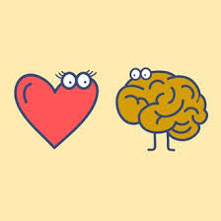
Mindfulness “How” Skills
Effectively:
Act from Wise Mind
Act as skillfully as you can
Decide to do what works, staying away from what is “fair” or “right”
Let go of the “principle of the matter” and keep you eyes on YOUR objective

Slide 23
Distress Tolerance

Slide 24
Distress tolerance: Goals of distress tolerance
Survive Crisis Situations
- without making them worse
Accept Reality
- replace suffering and being stuck with ordinary pain and possibility of moving forward
Become Free
- of having to satisfy the demands of your own desires, urges and intense emotions

Slide 25
Types of Distress Tolerance skills
Crisis Survival Strategies
- Short term pain
- Urges
- Impulses
Guidelines for Accepting Reality
- Long term pain

Slide 27
When to use Crisis Survival Skills
CRISIS= highly stressful, short-term, and intense pressure to resolve crisis now
Clients who show up in LR often feel that they are in a crisis situation and that they cannot solve their problems.
Goals → aiming at emotional and behavioral management rather than changing the situation (if it cannot be change in the moment)
Use Crisis Survival Skills when
1. You have intense pain that cannot be helped quickly
2. You want to act on your emotions, but it will only make things worse
3. Emotion mind threatens to overwhelm you, and you need to stay skillful
4. You are overwhelmed, yet demands must be met
5. Arousal is extreme, but problems cannot be solved immediately
* DON’T use for everyday problems, solving all your life problems, making your life worth living
Notes:
Last week you covered STOP (
Stop: do not just react. Freeze! Do no move a muscle! You emotions may try to make you act without thinking. Stay in Control!
Take a step back: take a step back from the situation. Take a break. Let go. Take a deep breath. Do not let your feelings make you act impulsively.
Observe: Notice what is going on inside and outside you. What is the situation? What are your thoughts and feelings? What are others saying and doing?
Proceed Mindfully: Act with awareness. In deciding what to do, consider your thoughts and feelings, the situation, and other peoples thoughts and feelings. Think about your goals. Ask Wise Mind: which actions will make it better or worse?)
And
Pros and Cons

Slide 28
Overview
Crisis Survival
Pros and Cons
STOP
TIP
Reality Acceptance
Radical Acceptance
Turning the Mind
Willingness
Half-Smiling and Willing Hands
Allowing the Mind
Self-Soothing
Improving the moment
Distracting

Slide 29
Pros and Cons
Pros
Cons
Tolerating
Distress
NOT
Tolerating
Distress

Slide 30
STOP Skills

Slide 31
TIPP Skills
Temperature
Intense Exercise
Paced Breathing
Paired Muscle Relaxation

Slide 32
TIPP Skills

Slide 33
T – Tipping the temperature of your face with cold water or cold packs on the face while holding your breath.
This induces the human dive reflex, which in turn sets off the parasympathetic system and reduces physiological and emotional arousal very quickly.
Methods: use a bowl of cold water, use an ice pack, splash cold water on the face
Cautions: Not recommend for individuals with heart problems, Short-effects (important to combine with other skills)

Slide 34
Practicing Temperature Management Skill

Slide 35
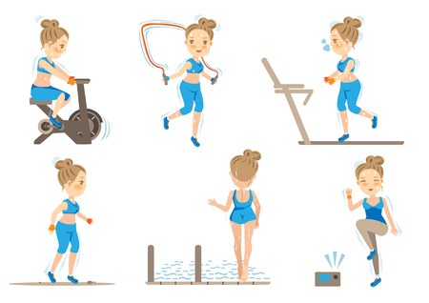
I – Intense exercise; engage in intense aerobic exercise of any kind for at least 20 minutes.
Intense exercise of any kind for 20-30 minutes or so can have a rapid effect on mood, decreasing negative mood and ruminative thoughts and increasing positive affect after exercising

Slide 36
P – Paced breathing
Slowing down the pace of inhaling and exhaling and breathing deeply from the abdomen.
Breathing in should be slower than breathing out (4:8; 5:7, etc.)

Slide 37
P – Paired muscle relaxation is paring of muscles relaxing with breathing out.
It is a variation of progressive muscle relaxation, which is widely used technique for anxiety disorders.
The strategy is to tense muscle groups, noticing the sensation of tension while breathing in, and then relax them by letting go of the tension, noticing the sensations as the muscle tension gradually goes down.
The goal is to increase awareness of both tension and relaxation.

Slide 38
Distress Tolerance Skills for lower SUDs without SI

Slide 39
Distracting Wise Mind ACCEPTS
Activities
Contributing
Comparison
Different Emotions
Pushing Away
Other Thoughts
Other Sensations

Slide 40
Self-Soothing 5 senses

Slide 41
Improving the moment

Slide 42
Reality Acceptance Skills
These are skills for how to live a life that is not the life you want (in this moment).

Slide 43
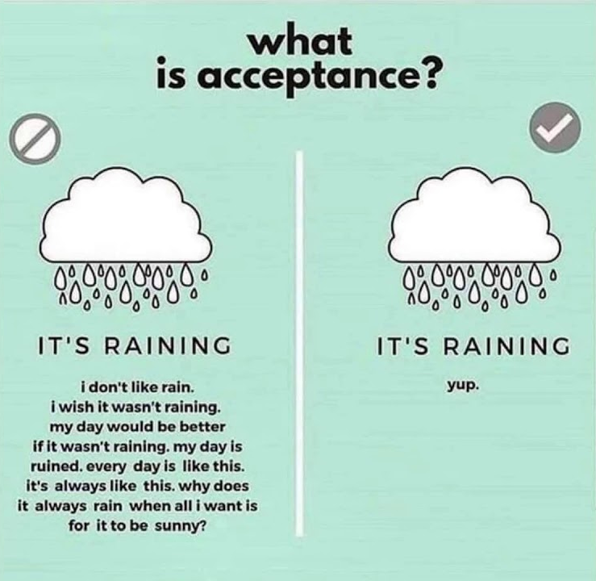
Radical Acceptance
What is radical acceptance?
What has to be accepted?
Why accept reality?

Slide 44
Reality acceptance skills
Reality acceptance skills are skills for accepting your life as it is in the moment.
They are particularly useful when you are living a life that is not the life you want.
* This skill is a key skill to determine how well patient can work on change skills in the LR

Slide 45
Overview of SIX BASIC Reality Acceptance skills
Radical Acceptance
Turning the mind
Willingness
Half-Smiling and Willing hands
Allowing the mind: Mindfulness of Current Thoughts

Slide 46
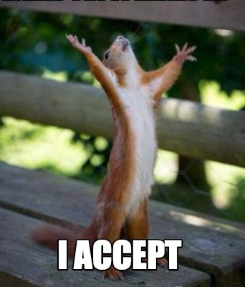
Guidelines for Accepting Reality
Observing Your Breath
Half-smiling
Awareness
Radical Acceptance
Turning the Mind
Willingness (over willfulness)

Slide 47
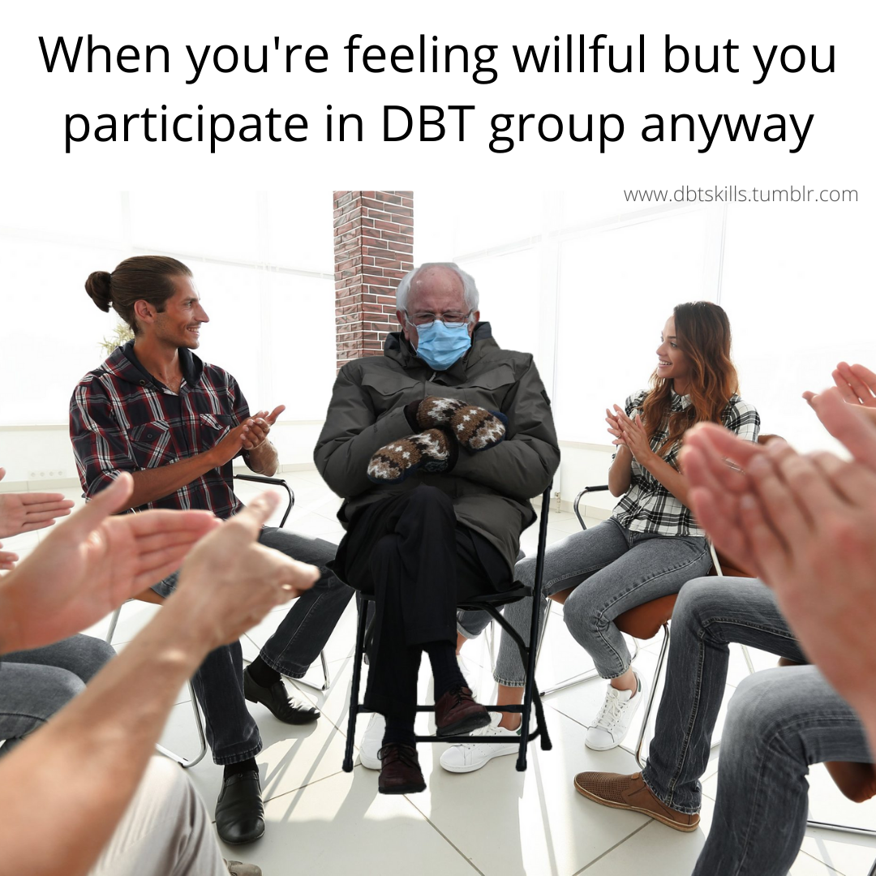
Willingness: Half-Smile & Willing Hands
Accepting reality with your body
Body posture practice/mindfulness

Slide 48
Mindfulness of Current Thoughts
Mindfulness of Current Thoughts
1. Observe your thoughts
2. Adopt a curious mind
3. Remember: you are not your thoughts
4. Don’t block or suppress thoughts
Practice Mindfulness of Thoughts
1. By Observing them
2. By using words and voice tone
3. With Opposite Action
4. With Imagery

Slide 49
Mindfulness of Current Emotions

Slide 50
Q&A

